Slide 1

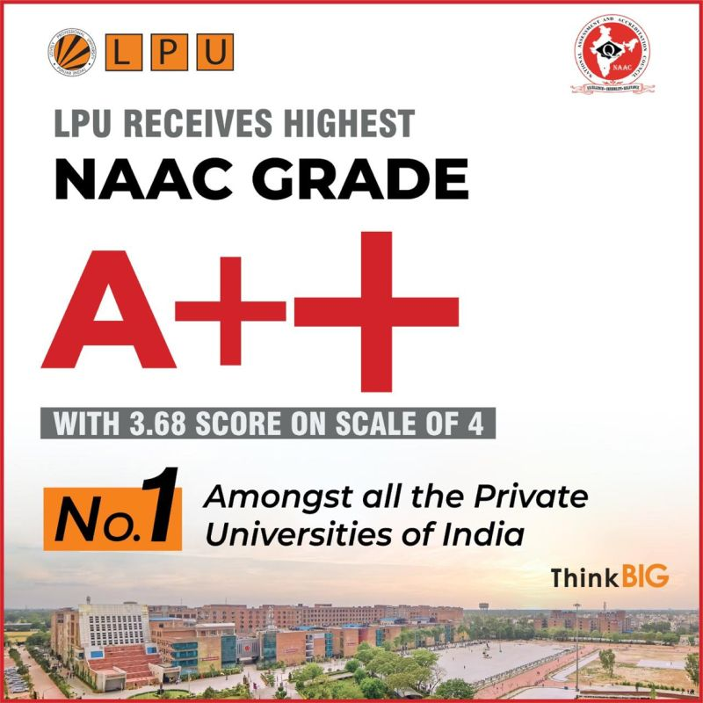
PHY110
ENGINEERING PHYSICS

Slide 2
Zero Lecture
Zero lecture is the lecture which acquaint the students about the structure of the course. It enables the learners to understand the vision of the course and provides a clear mental checklist of various course objectives to accomplish.

Slide 3



University Vision and Mission

Slide 4


VISION
To be a premier academic institution, recognized internationally for its contribution to industry and society through excellence in teaching, learning, research, internationalization, entrepreneurship and leadership.

Slide 5


To transform education through academic rigor, practical orientation, and outcome-based teaching.
MISSION
To develop and implement a relationship of cooperation between
industry and academia.
To undertake impactful research addressing local, national, and global challenges.
To prepare graduates to be lifelong learners with strong analytical and leadership skills.
To develop global professionals and entrepreneurs with an innovative spirit, tolerance, and desire to make a difference in society.

Slide 6
School Vision & Mission
Vision
To be a globally recognized school through excellence in teaching, learning and research for creating Computer Science professionals, leaders and entrepreneurs of the future contributing to society and industry for sustainable growth.
Mission
M1: To build computational skills through hands-on and practice based learning with measurable outcomes.
M2: To establish a strong connect with industry for in-demand technology driven curriculum.
M3: To build the infrastructure for meaningful research around societal problems.
M4: To nurture future leaders through research-infused education and lifelong learning.
M5: To create smart and ethical professionals and entrepreneurs who are recognized globally.

Slide 7

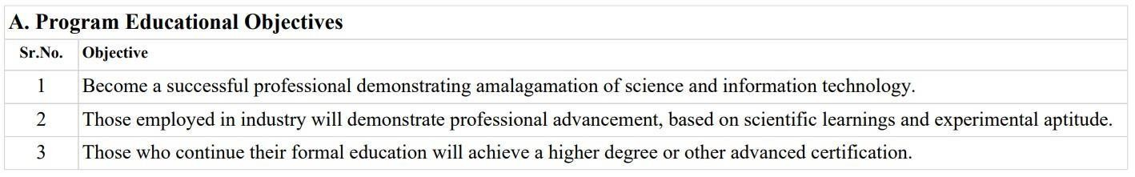
Program Information
Program Code: P132
Program Name: B. Tech. Computer Science and Engineering
This Bachelor of Technology program offered by Lovely Professional University has a minimum duration of 4 years and is offered under the Semester system through Regular mode. It is a standalone program based on the credit system.
#The medium of Instruction in this program is English.

Slide 8
Program Educational Objectives
PEO1: Graduates will be able to apply technical knowledge to solve industrial problems in the field of mechanical engineering.
PEO2: Graduates with exposure to interdisciplinary skills will have the potential to become successful innovators or entrepreneurs engaged in technology development and deployment.
PEO3: Graduates with their lifelong learning skills and research capabilities will be able to pursue higher studies and research careers at national/international levels.
PEO4: Graduates will demonstrate sensitivity to environmental and sustainability issues while contributing to society.

Slide 9

B.
 | Program Outcomes
 | . No. | Outcomes | Headings | Description
1 |  | PO1 | Engineering knowledge | Apply the knowledge of mathematics, science, engineering fundamentals, and an engineering specialization to the solution of complex engineering problems.
2 |  | PO2 | Problem analysis | Identify, formulate, review research literature, and analyse complex engineering problems reaching substantiated conclusions using first principles of mathematics, natural sciences, and engineering sciences.
3 |  | PO3 | Design/development of solutions | Design solutions for complex engineering problems and design system components or processes that meet the specified needs with appropriate consideration for the public health and safety, and the cultural, societal, and environmental considerations.
4 |  | PO4 | Conduct investigations of complex problems | Use research-based knowledge and research methods including design of experiments, analysis and interpretation of data, and synthesis of the information to provide valid conclusions.
5 |  | PO5 | Modern tool usage | Create, select, and apply appropriate techniques, resources, and modern engineering and IT tools including prediction and modelling to complex engineering activities with an understanding of the limitations.
6 |  | PO6 | The engineer and society | Apply reasoning informed by the contextual knowledge to assess societal, health, safety, legal and cultural issues and the consequent responsibilities relevant to the professional engineering practice.
7 |  | PO7 | Environment and sustainability | Understand the impact of the professional engineering solutions in societal and environmental contexts, and demonstrate the knowledge of, and need for sustainable development.
S
9

Slide 10
8. |  | PO8 | Ethics | Apply ethical principles and commit to professional ethics and responsibilities and norms of the engineering practice.
9. |  | PO9 | Individual and team work | Function effectively as an individual, and as a member or leader in diverse teams, and in multidisciplinary settings.
10 | . | PO10 | Communication | Communicate effectively on complex engineering activities with the engineering community and with society at large, such as, being able to comprehend and write effective reports and design documentation, make effective presentations, and give and receive clear instructions.
1 |  | PO11 | Project management and finance | Demonstrate knowledge and understanding of the engineering and management principles and apply these to one’s own work, as a member and leader in a team, to manage projects and in multidisciplinary environments.
1 | . | PO12 | Life-long learning | Recognize the need for, and have the preparation and ability to engage in independent and life-long learning in the broadest context of technological change
11
12

Slide 11
 | C. Program Specific Options
 | Sr. No. |  | Outcomes |  |  | Description
 | 1. |  | PSO1 |  |  | Apply basic knowledge in the areas such as Software Engineering, Networking and Security, Database Management Systems, Intelligent Systems, Operating Systems, Programming Skills and System Architecture for building Software products along with the integration of futuristic technologies.
 | 2. |  | PSO2 |  |  | Provide effective and efficient real time solutions using attained knowledge in inter-disciplinary domains for societal benefits through hands-on projects or hackathons or technical challenges or global competitions.
 | A. PSO mapping with core courses
 | Course code | Course title |  | PO1 | PO2 |  | PO3 | PO4 | PO5 | PO6 | PO7 | PO8 | PO9 | PO10 | PO11 | PO12 | PSO1 | PSO2 | PSO3 | PSO4
 | PHY110 | Engineering Physics |  | Yes | Yes |  | Yes | Yes |  |  |  |  |  |  |  | Yes | Yes
11

Slide 12

What you will study here in this course?

Slide 13

But how to find the syllabus in UMS ?
UMS log in >> UMS navigation
>> Learning Management System
>> Academic course syllabus
>> syllabus files
>> select the session
>> PHY110

Slide 14
Course Outcomes:
CO 1 : understand the basic principles of physics to lay the foundation for various
engineering courses
CO 2: explain the principle and working of lasers and optical fiber for their wide
applications.
CO 3: employ the principle of quantum mechanics to solve Schrodinger equations
for standard systems.
CO 4: articulate the physics of solids to understand their properties.
CO 5: determine the properties of engineering materials.

Slide 15
Course Assessment Model
L: 3.0 T: 0.0 P: 0.0 Cr: 3.0
Attendance
5
Continuous Assessment 25 Mid Term Exam
End Term Exam
20
50
Total 100 Marks
MTE: 100% MCQ
ETE: 100% MCQ

Slide 16
Continuous Assessment (CA)
CA category C010102
Two Class Tests (One best out of two)
  One pre-MTE (30 Marks, allotment week – 4 and submission week - 5)
  one post-MTE (30 Marks, allotment week – 11 and submission week - 12)
One assignment (Term paper, Compulsory task) Lab@Home 30 marks (allotment week – 2 and submission week - 10)

Slide 17
Rubric
One assignment Labs @ Home (Compulsory) 30 marks
Marks split up of Written report [20 Marks]
  Lab@ Home review submission (students will produce the layout and content outline of the given topic). [5 Marks]
  Presenting accurate information, highlighting key principles, supporting facts and details in the report. [5 marks]
  Observation, conclusion, and references
[5Marks]
(d ) Completeness of the Problem/Task and References cited. [5Marks]
Viva
[10Marks]

Slide 18
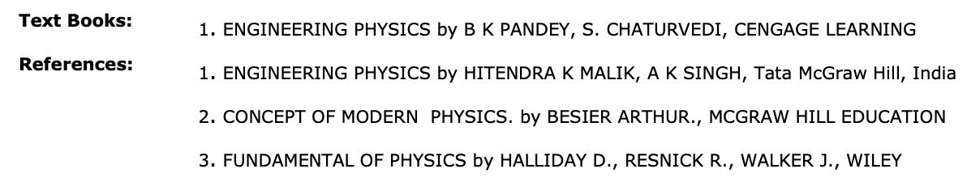
Text book and Reference Books

Slide 19
Syllabus

Slide 20
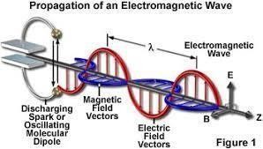
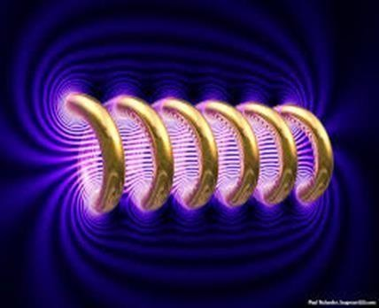

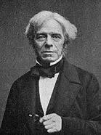
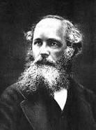
Unit I
Electromagnetic Theory
Syllabus
Scalar and vectors fields
Concept of gradient, divergence and curl
Gauss theorem and Stokes theorem (qualitative)
Poisson and Laplace equations, continuity equation
Maxwell electromagnetic equations (differential and integral forms)
Physical significance of Maxwell equations, Ampere Circuital Law
Maxwell displacement current and correction in Ampere Circuital Law.
Michael Faraday
James Clerck Maxwell

Slide 21

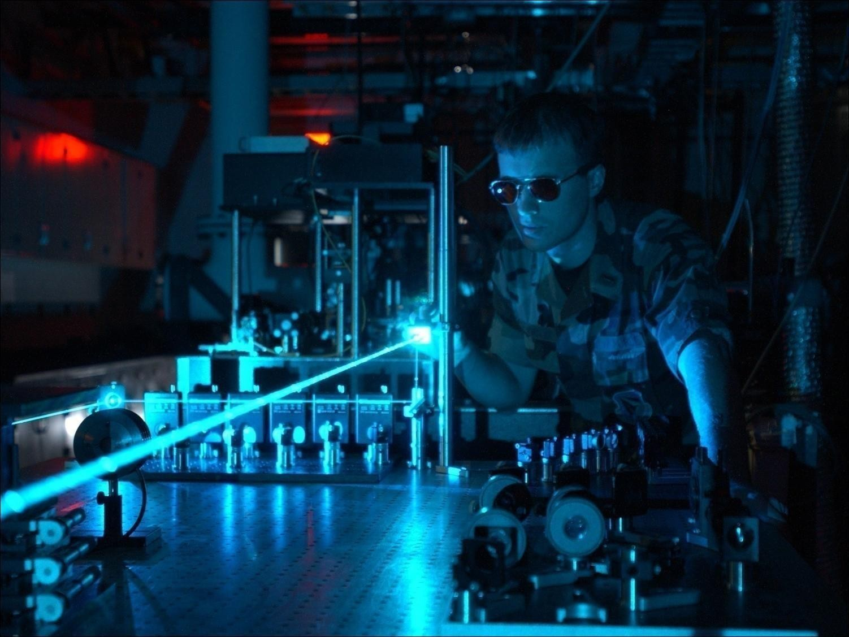
Unit II
Laser and Applications
Syllabus
Fundamentals of laser- energy levels in atoms
Radiation matter interaction, Absorption of light
Spontaneous emission of light, stimulated emission of light
Population of energy levels, Einstein A and B coefficients
Metastable state, population inversion, lasing action
Properties of laser, resonant cavity, excitation mechanisms
Nd - YAG, He-Ne Laser, Semiconductor Laser
Applications of laser in holography.

Slide 22
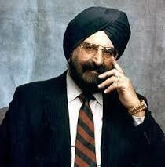

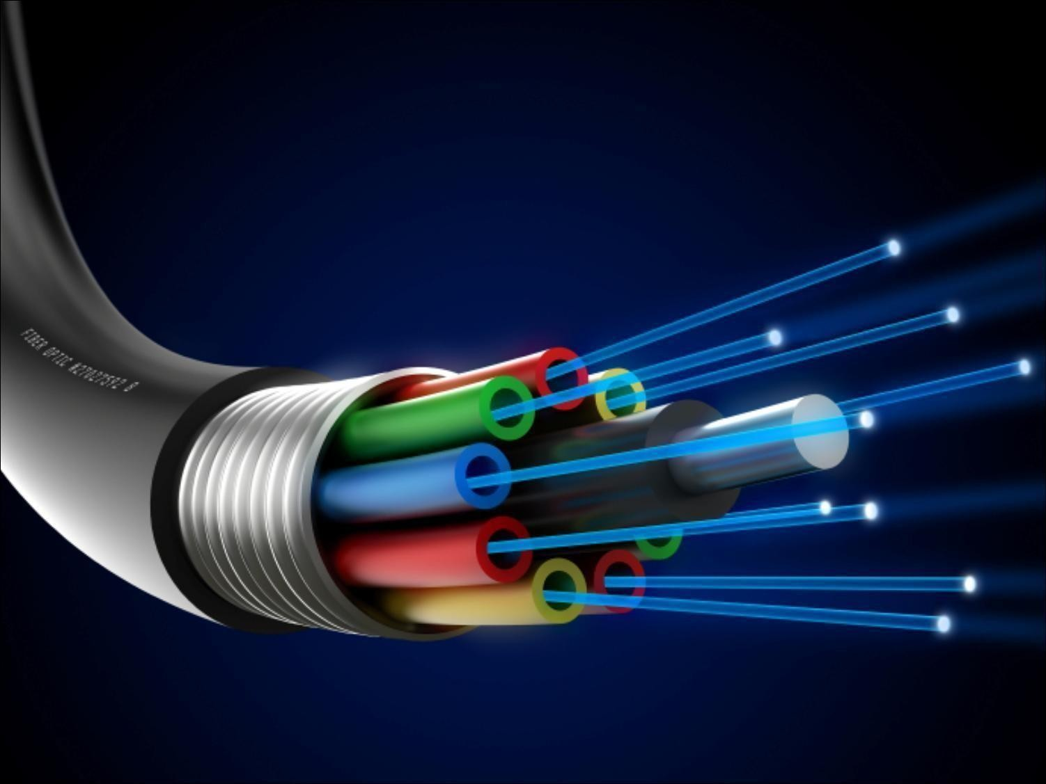
Unit III
Fiber Optics
Fiber optics introduction
Optical fiber as a dielectric wave guide
Total internal reflection, acceptance angle
Numerical aperture, relative refractive index
V-number
Step index and graded index fibers
Losses associated with optical fibers

Slide 23


Unit IV
Quantum Mechanics
Need of quantum mechanics
Photoelectric effect, Concept of de Broglie matter waves
Wavelength of matter waves in different forms
Heisenberg uncertainty principle
Concept of phase velocity and group velocity (qualitative)
Wave function and its significance
Schrodinger time dependent and time independent equation
Particle in a box

Slide 24
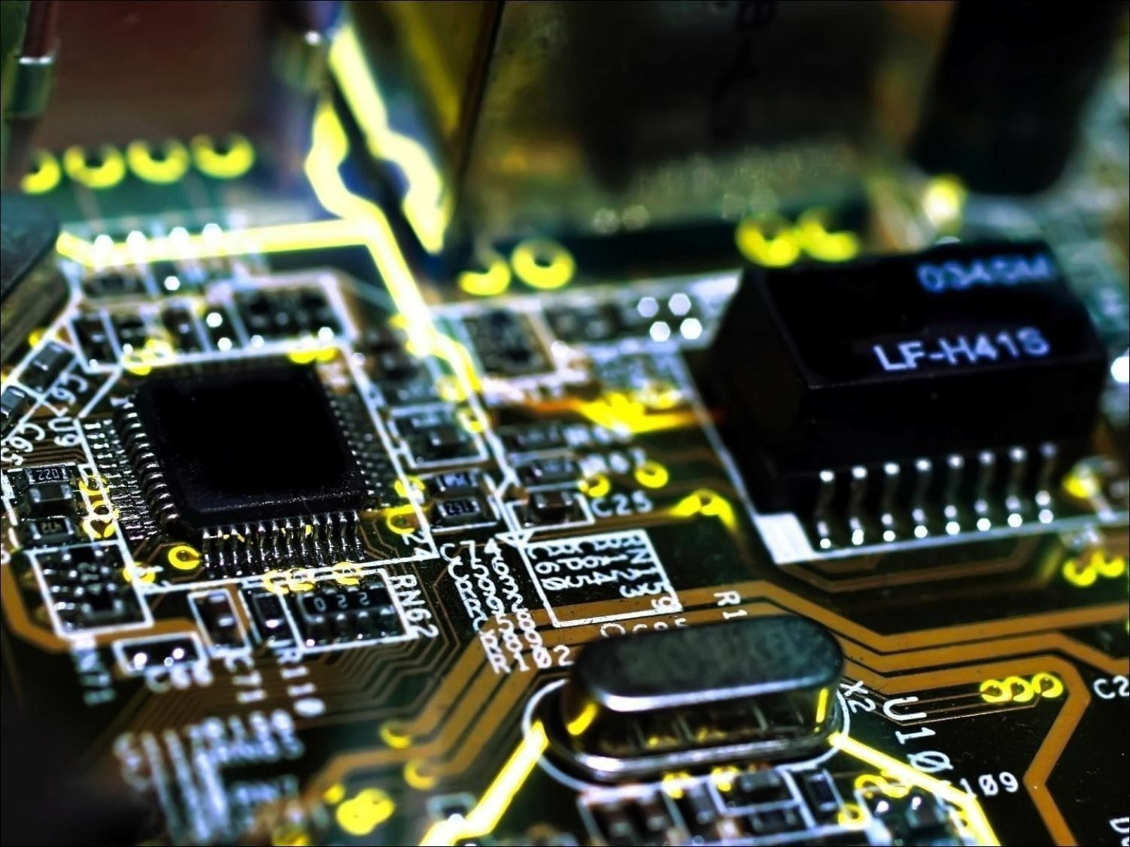
Unit V
Solid State Physics
Free electron theory, diffusion and drift current
Fermi energy, Fermi-Dirac distribution function
Band theory of solids - formation of allowed and Forbidden energy bands
Concept of effective mass - electrons and holes
Hall effect (with derivation)
Semiconductors and insulators
Fermi level for intrinsic and extrinsic semiconductors
Direct and indirect band gap semiconductors

Slide 25
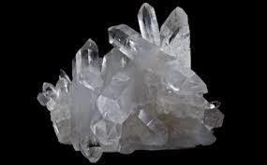

Unit VI
Introduction to Engineering materials
Syllabus
Introduction to dielectric material
Magnetic materials: Dia, Para, Ferromagnetic
Piezoelectric materials
Direct and inverse Piezoelectric methods
Superconducting materials: properties, applications
Meissner Effect
Type 1 & Type – 2 superconductors

Slide 26
Course Orientation
COMPETITIVE EXAMINATION (Higher Education)
COMPETITIVE EXAMINATION (Civil Services)
KNOWLEDGE ENHANCEMENT

Slide 27


